Slide 1
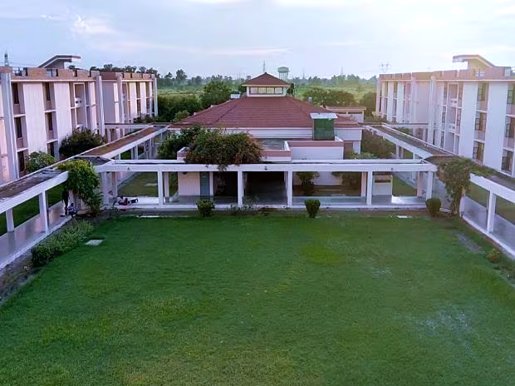

Effect of Substrate Wettability and Flexibility on the Initial
Stage of Water Vapor Condensation
Presented By: Bhumesh(230102008)
Sahil (210897)
Course: Molecular Simulations in
Mechanical Engineering
Course Guide: Prof. Manjesh K. Singh

Slide 2
Motivation
1

Slide 3
Motivation
Vapor condensation is a ubiquitous phenomena^{1,2}.
Efficient condensation has extensive application in areas like water harvesting which alleviates the water shortage problem in arid areas³.
Another is to enhance the heat transfer in heat exchangers by changing the condensation mode which may lead to a decrease in the heat ex- changer size⁴.
1

Slide 4
Motivation
Vapor condensation is a ubiquitous phenomena^{1,2}.
Efficient condensation has extensive application in areas like water harvesting which alleviates the water shortage problem in arid areas³.
Another is to enhance the heat transfer in heat exchangers by changing the condensation mode which may lead to a decrease in the heat ex- changer size⁴.
1. Rogers et al. At., Mol., Opt. Phys., 1988, 38, 5303–5309.
2. Winkler et al, Phys. Rev. Lett., 2004, 93, 075701
3. Parker el al, Nature, 2001, 414, 33–34.
4. Miljkovic et al, MRS Bull., 2013, 38, 397–406.
1

Slide 5
Objective behind the Work
2

Slide 6
Objective behind the Work
As many study shows that the wettability of the surface is plays important role in
the condensation process.⁵
Dropwise condensation found better for the condensation and has the 5-7 times higher
heat transfer performance.⁶
To understand the Condensation process over the different types of substrate in terms
of rigidness.
To study the how hydrophilic and hydrophobic nature of the substrate is going
to affect the condensation process.
Which type of condensation mode will give the more heat transfer performance?.
5. Wen et al, J. Heat Transfer, 2016, 138, 071501.
6. Rose, Proc. Inst. Mech. Eng., Part A, 2002, 216, 115–128
2

Slide 7
Types Of Condensation
3

Slide 8
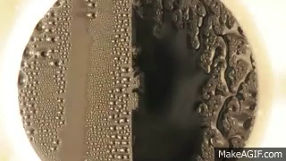
Types Of Condensation
Film-wise
Dropwise
3

Slide 9
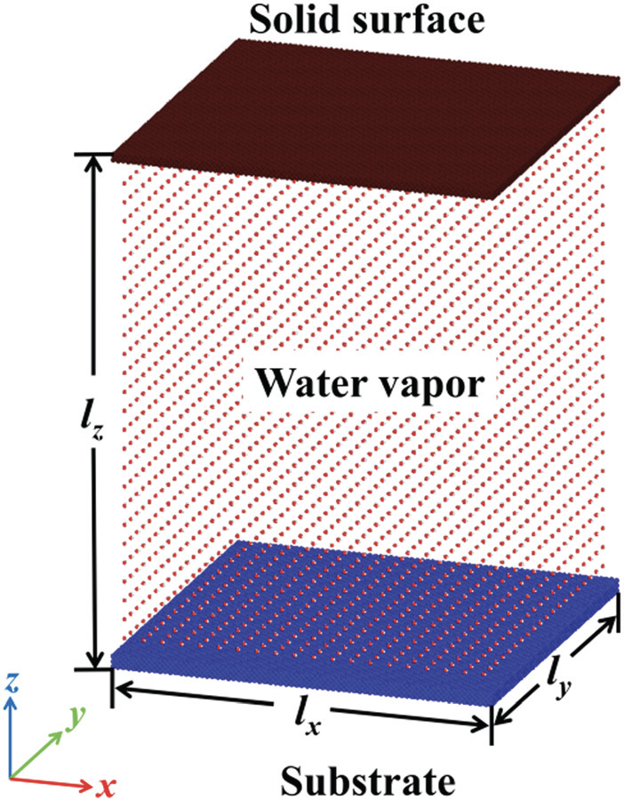
Method and Approach
LAMMPS
Periodic Boundary Conditions
4

Slide 10
Method and Approach
LAMMPS
Periodic Boundary Conditions
4

Slide 11
Method and Approach
LAMMPS
Periodic Boundary Conditions
Box Size=263 A° * 263 A° * 356 A°
4

Slide 12
LAMMPS
Method and Approach
Periodic Boundary Conditions
Box Size=263 A° * 263 A° * 356 A°
10,000 water molecules
4

Slide 13
LAMMPS
Periodic Boundary Conditions
Method and Approach
Box Size=263 A° * 263 A° * 356 A°
10,000 water molecules
33,302 Ni solid surface molecule
4

Slide 14
LAMMPS
Periodic Boundary Conditions
Box Size=263 A* 263 A* 356 A
Method and Approach
10,000 water molecules
33,302 Ni solid surface molecule
4

Slide 15
LAMMPS
Periodic Boundary Conditions
Box Size=263 A* 263 A* 356 A
Method and Approach
10,000 water molecules
33,302 Ni solid surface molecule
52,563 Cu substrate molecule
4

Slide 16
LAMMPS
Periodic Boundary Conditions
10,000 water molecules
Box Size=263 A* 263 A* 356 A
Method and Approach
33,302 Ni solid surface molecule
52,563 Cu substrate molecule
Lennard- Jones Potential
For Ni and Cu atoms
4

Slide 17
LAMMPS
Periodic Boundary Conditions
10,000 water molecules
Box Size=263 A* 263 A* 356 A
33,302 Ni solid surface molecule
Method and Approach
52,563 Cu substrate molecule
Lennard- Jones Potential
For Ni and Cu atoms
Water Model TIP4P-Ew
4

Slide 18
LAMMPS
Periodic Boundary Conditions
10,000 water molecules
Box Size=263 A* 263 A* 356 A
33,302 Ni solid surface molecule
52,563 Cu substrate molecule
Method and Approach
Lennard- Jones Potential
For Ni and Cu atoms
Water Model TIP4P-Ew⁸
Substrate thickness 7.23 A°
8. Horn et al, J. Chem. Phys.,2004, 120, 9665–9678.
4

Slide 19
LAMMPS
Periodic Boundary Conditions
Lennard- Jones Potential
For Ni and Cu atoms
10,000 water molecules
Box Size=263 A* 263 A* 356 A
33,302 Ni solid surface molecule
52,563 Cu substrate molecule
Method and Approach
Water Model TIP4P-Ew
Substrate thickness 7.23 A°
Solid Surface thickness 3.524 A°
4

Slide 20
LAMMPS
Periodic Boundary Conditions
Lennard- Jones Potential
For Ni and Cu atoms
10,000 water molecules
Box Size=263 A* 263 A* 356 A
Water Model TIP4P-Ew
33,302 Ni solid surface molecule
52,563 Cu substrate molecule
Method and Approach
Substrate thickness 7.23 A°
Solid Surface thickness 3.524 A°
NVT ensemble
4

Slide 21
LAMMPS
Periodic Boundary Conditions
Lennard- Jones Potential
For Ni and Cu atoms
10,000 water molecules
Box Size=263 A* 263 A* 356 A
Water Model TIP4P-Ew
33,302 Ni solid surface molecule
Substrate thickness 7.23 A
52,563 Cu substrate molecule
Method and Approach
Solid Surface thickness 3.524 A
NVT ensemble
Langevin Thermostat
Temperature=500K
4

Slide 22
LAMMPS
Solid Surface thickness 3.524 A
Periodic Boundary Conditions
Lennard- Jones Potential
For Ni and Cu atoms
10,000 water molecules
Box Size=263 A* 263 A* 356 A
Water Model TIP4P-Ew
33,302 Ni solid surface molecule
Substrate thickness 7.23 A
52,563 Cu substrate molecule
Method and Approach
NVT ensemble
Langevin Thermostat
Temperature=500K
For 2,00,000 steps
4

Slide 23
LAMMPS
Solid Surface thickness 3.524 A
Periodic Boundary Conditions
Lennard- Jones Potential
For Ni and Cu atoms
10,000 water molecules
Box Size=263 A* 263 A* 356 A
Water Model TIP4P-Ew
NVT ensemble
33,302 Ni solid surface molecule
Substrate thickness 7.23 A
52,563 Cu substrate molecule
Method and Approach
Langevin Thermostat
Temperature=500K
For 2,00,000 steps
Then temp decreased to 300K
4

Slide 24
LAMMPS
Solid Surface thickness 3.524 A
Periodic Boundary Conditions
Lennard- Jones Potential
For Ni and Cu atoms
Langevin Thermostat
Temperature=500K
10,000 water molecules
Box Size=263 A* 263 A* 356 A
Water Model TIP4P-Ew
NVT ensemble
33,302 Ni solid surface molecule
Substrate thickness 7.23 A
52,563 Cu substrate molecule
Method and Approach
For 2,00,000 steps
Then temp decreased to 300K
For 50,00,000 steps
4

Slide 25
LAMMPS
Solid Surface thickness 3.524 A
Periodic Boundary Conditions
Lennard- Jones Potential
For Ni and Cu atoms
Langevin Thermostat
Temperature=500K
10,000 water molecules
Box Size=263 A* 263 A* 356 A
For 2,00,000 steps
Water Model TIP4P-Ew
NVT ensemble
33,302 Ni solid surface molecule
Substrate thickness 7.23 A
52,563 Cu substrate molecule
Method and Approach
Then temp decreased to 300K
For 50,00,000 steps
1 fs timestep
4

Slide 26
LAMMPS
Solid Surface thickness 3.524 A
Periodic Boundary Conditions
Lennard- Jones Potential
For Ni and Cu atoms
Langevin Thermostat
Temperature=500K
10,000 water molecules
Box Size=263 A* 263 A* 356 A
For 2,00,000 steps
Water Model TIP4P-Ew
NVT ensemble
33,302 Ni solid surface molecule
Substrate thickness 7.23 A
52,563 Cu substrate molecule
Then temp decreased to 300K
Method and Approach
For 50,00,000 steps
1 fs timestep
Std. Velocity Verlet algorithm for numerical integration
4

Slide 27
LAMMPS
Solid Surface thickness 3.524 A
Periodic Boundary Conditions
Lennard- Jones Potential
For Ni and Cu atoms
Langevin Thermostat
Temperature=500K
10,000 water molecules
Box Size=263 A* 263 A* 356 A
For 2,00,000 steps
Water Model TIP4P-Ew
NVT ensemble
33,302 Ni solid surface molecule
Substrate thickness 7.23 A
52,563 Cu substrate molecule
For 50,00,000 steps
Then temp decreased to 300K
Method and Approach
1 fs timestep
Std. Velocity Verlet algorithm for numerical integration
4

Slide 28
Potential
5

Slide 29
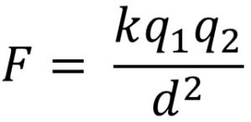
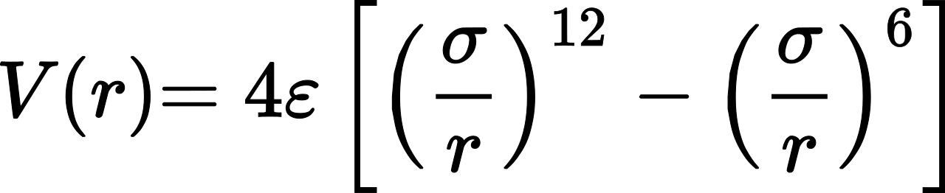
Potential
Lennard Jones Potential for Ni-Ni and Cu-Cu atoms while LJ + Coulombic interaction for
water TIP4P-Ew model because of O and H atoms having the charge.
No interaction between Cu and Ni is considered.
4
Coulombic Force Equation:
Lennard Jones Equation:

Slide 30
Potential
Lennard Jones Potential for Ni-Ni and Cu-Cu atoms while LJ + Coulombic interaction for
water TIP4P-Ew model because of O and H atoms having the charge.
No interaction between Cu and Ni is considered.
Lennard Jones Equation:
4
Coulombic Force Equation:

Slide 31
Potential
Lennard Jones Potential for Ni-Ni and Cu-Cu atoms while LJ + Coulombic interaction for
water TIP4P-Ew model because of O and H atoms having the charge.
No interaction between Cu and Ni is considered.
Lennard Jones Equation:
Coulombic Force Equation:
4

Slide 32
Values for σ_{ij} and 𝜺_{ij}
6

Slide 33
Values for σ_{ij} and 𝜺_{ij}
σ _{Ni-Ni} = 2.552 A°
σ_{Cu-Cu} = 2.616 A°
𝜺_{Ni-Ni} = 5.65kcal/mol
𝜺_{Cu-Cu}= 4.72kcal/mol
σ_{O-O} = 3.116435 A°
𝜺_{O-O} = 0.16275kcal/mol
𝜺_{water-Cu} = 0.1-0.6 kcal/mol A^{°2(}For hydrophobic to hydrophilic nature)
6

Slide 34
Values for σ_{ij} and 𝜺_{ij}
σ _{Ni-Ni} = 2.552 A°
σ_{Cu-Cu} = 2.616 A°
𝜺_{Ni-Ni} = 5.65kcal/mol
𝜺_{Cu-Cu}= 4.72kcal/mol
σ_{O-O} = 3.116435 A°
𝜺_{O-O} = 0.16275kcal/mol
𝜺_{water-Cu} = 0.1-0.6 kcal/mol A^{°2(}For hydrophobic to hydrophilic nature)
Cut-off distance for LJ potential= 10 A°
Cut-off distance for coulombic interaction= 12 A°
Energy minimisation method – PPPM using CG algorithm
6

Slide 35
Values for σ_{ij} and 𝜺_{ij}
σ _{Ni-Ni} = 2.552 A°
σ_{Cu-Cu} = 2.616 A°
𝜺_{Ni-Ni} = 5.65kcal/mol
𝜺_{Cu-Cu}= 4.72kcal/mol
σ_{O-O} = 3.116435 A°
𝜺_{O-O} = 0.16275kcal/mol
𝜺_{water-Cu} = 0.1-0.6 kcal/mol A^{°2(}For hydrophobic to hydrophilic nature)
Cut-off distance for LJ potential= 10 A°
Cut-off distance for coulombic interaction= 12 A°
Energy minimisation method – PPPM using CG algorithm
Cu-like atom is constrained to its lattice site by harmonic potential E_{H} (r)=K(r−r₀⁾²
wherer₀ is the equilibrium position of the atom and K is the spring constant
which authors have used to alter the flexibility of the substrate.
Usually K=20 kcal/mol A°² means flexible substrate and K=500 kcal/mol A°²
means rigid substrate.
6

Slide 36
Contact angle of different substrate
𝜺_{water-Cu} (kcal/mol) | 0.1 | 0.2 | 0.3 | 0.4 | 0.5 | 0.6
Rigid Substrate(K=500kcal/mol A^{°2}) | 136° | 110° | 81° | 38° | 17° | 9°
Flexible Substrate(K=20kcal/mol A^{°2}) | 152° | 119° | 85° | 47° | 26° | 14°
7

Slide 37
Condensation of Water vapor over solid surface
with hydrophobic to hydrophilic nature of substrate
8

Slide 38
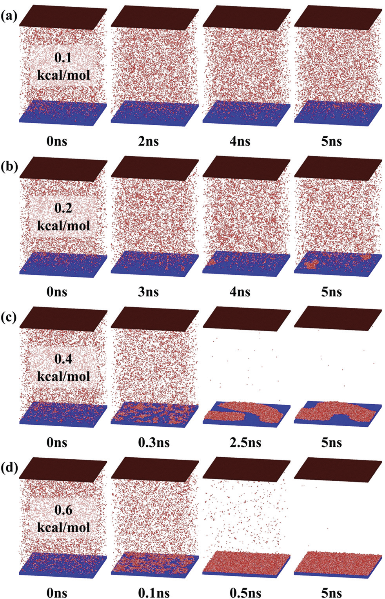
Condensation of Water vapor over solid surface
with hydrophobic to hydrophilic nature of substrate
8

Slide 39
Condensation of Water vapor over solid surface
with hydrophobic to hydrophilic nature of substrate
8

Slide 40
Condensation of Water vapor over solid surface
with hydrophobic to hydrophilic nature of substrate
8

Slide 41
Evolution of Number of water molecules in largest size cluster
9

Slide 42
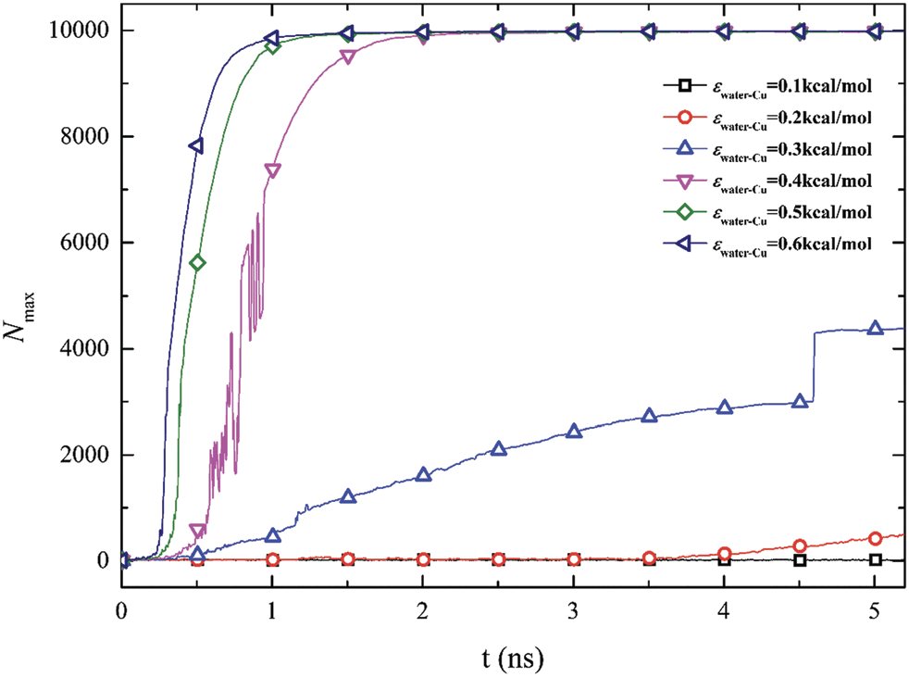
Evolution of Number of water molecules in largest size cluster
9

Slide 43
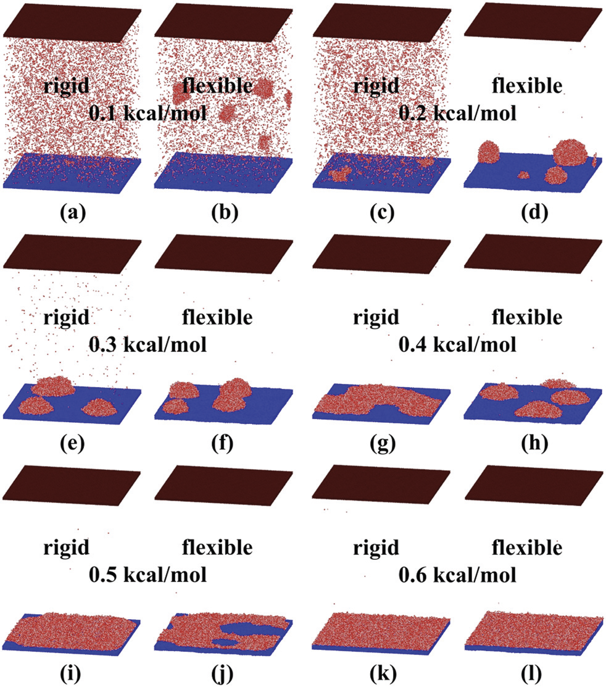
Comparison of condensation mode between rigid
and flexible substrates
10

Slide 44
Comparison of condensation mode between rigid
and flexible substrates.
10

Slide 45
Comparison of condensation mode between rigid
and flexible substrates.
10

Slide 46
Comparison of condensation mode between rigid
and flexible substrates.
10

Slide 47
Comparison of condensation mode between rigid
and flexible substrates.
10

Slide 48
The evolution of the number of clusters in simulation
systems of different condensation processes
11

Slide 49
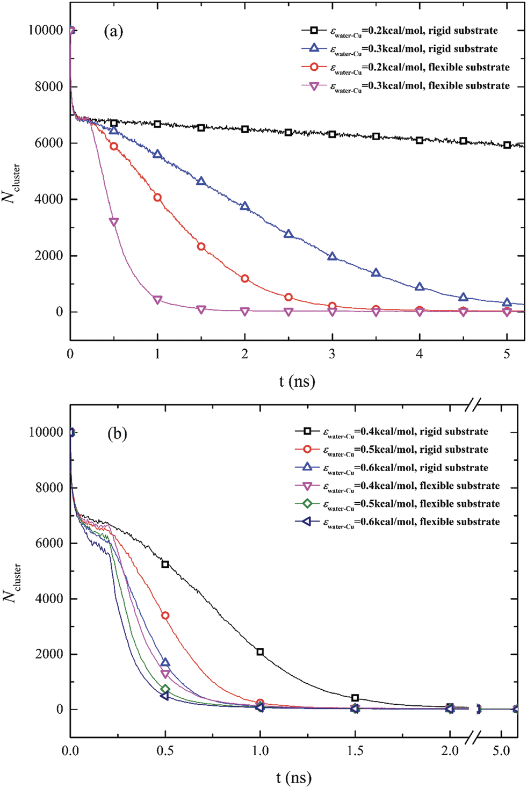
The evolution of the number of clusters in simulation
systems of different condensation processes
11

Slide 50
The evolution of the number of clusters in simulation
systems of different condensation processes
11

Slide 51
The evolution of the number of clusters in simulation
systems of different condensation processes
11

Slide 52
Heat transfer performance of the rigid substrate
12

Slide 53
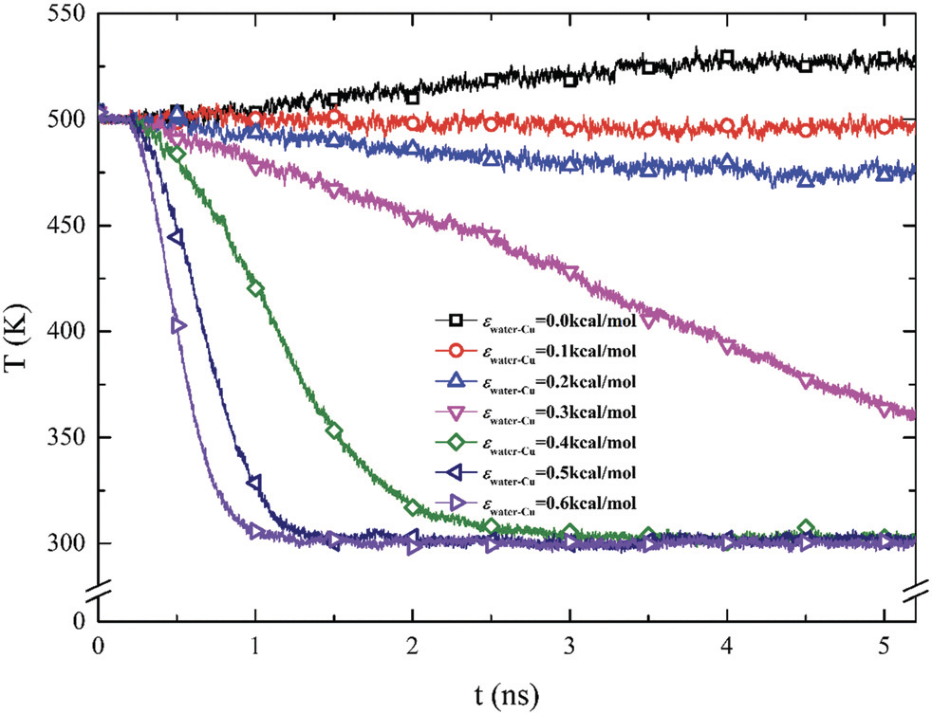
Heat transfer performance of the rigid substrate
12

Slide 54
Comparison of heat transfer performance between
rigid and flexible substrates
13

Slide 55
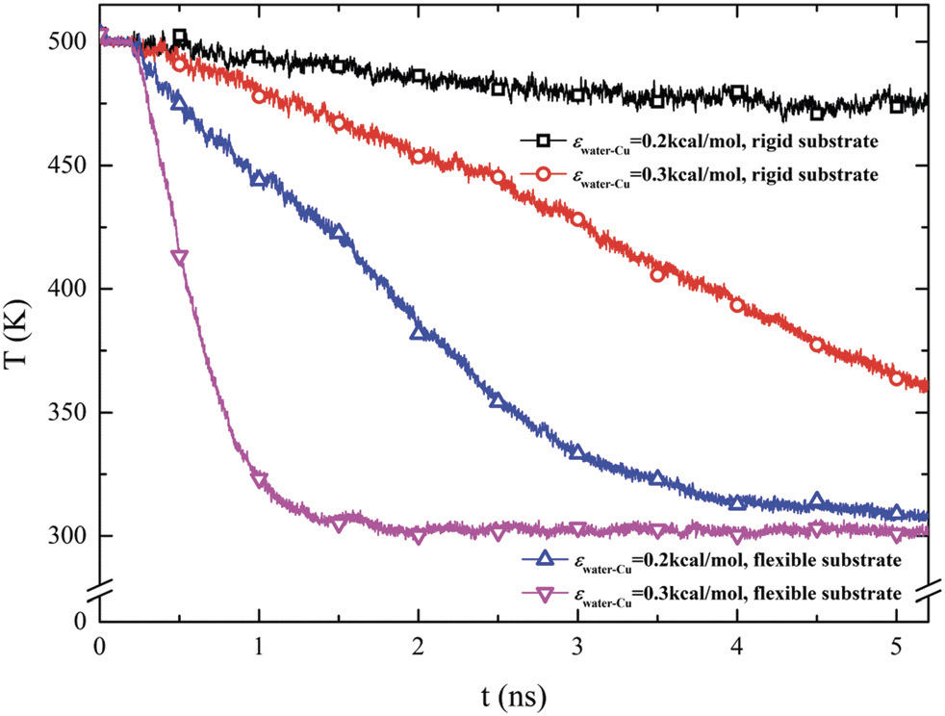
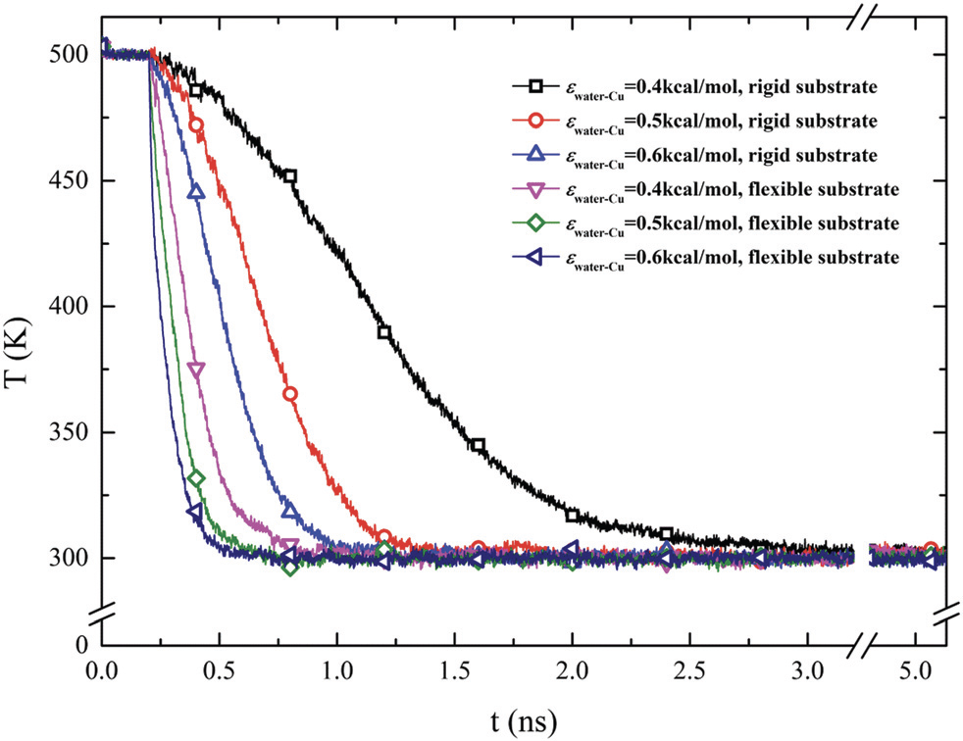
Comparison of heat transfer performance between
rigid and flexible substrates
13

Slide 56
Comparison of heat transfer performance between
rigid and flexible substrates
13

Slide 57
Comparison of heat transfer performance between
rigid and flexible substrates
13

Slide 58
Conclusion
14

Slide 59
Conclusion
The condensation mode of water vapor on the substrate is mainly determined by the substrate wettability
14

Slide 60
Conclusion
The condensation mode of water vapor on the substrate is mainly determined by the substrate wettability
when substrate with the same flexibility changes from complete non-wetting to complete wetting, the condensation rate increases and the condensation mode changes from NC to DWC to IFWC and FWC mode.
14

Slide 61
Conclusion
The condensation mode of water vapor on the substrate is mainly determined by the substrate wettability
when substrate with the same flexibility changes from complete non-wetting to complete wetting, the condensation rate increases and the condensation mode changes from NC to DWC to IFWC and FWC mode.
On comparing the condensation process on a rigid substrate with the substrate with the same wettability, it is found that nucleation density is higher on a flexible substrate.
14

Slide 62
Thank You!!!

